Slide 1
BENCHMARK 1 WIREFRAME
Consumer Perspective
“Searching for and joining a carpool group”

Slide 2
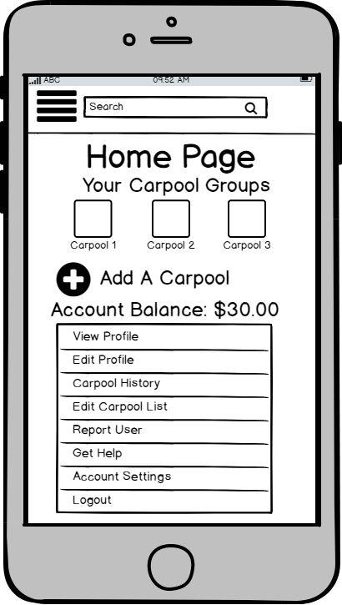
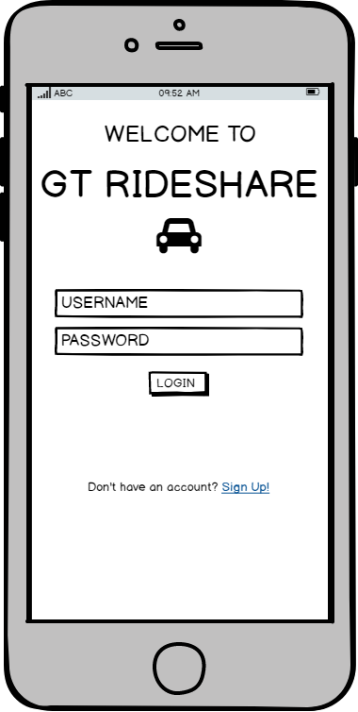

1
2
All of the carpools the user is currently a member of are openly displayed on the home page
The amount of money the user has in their account is located on the home page so they can easily see if they have enough money their account for a ride.
The home page has a list of setting and editing options that can be accessed no matter what page the user is on by pressing the menu button at the top of the screen
If the consumer/rider already has an account they can log in
The consumer can press the plus button to find a carpool to join

Slide 3
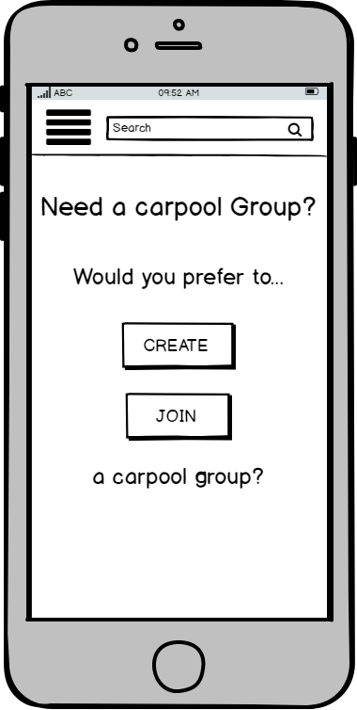
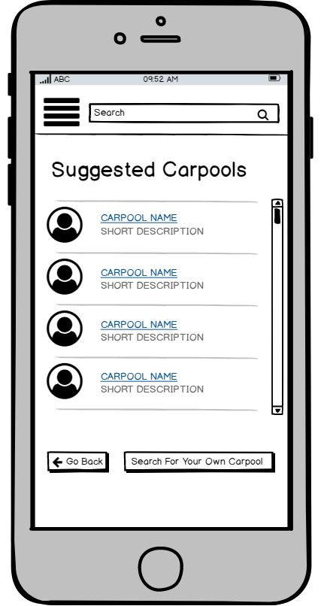
3
4
The app gives the user a list of suggested carpools and/or drivers they would be eligible to carpool with based on the schedule and carpooling preferences the user lists in their profile
The consumer can choose to join a pre-existing carpool or piece together their own carpool group
The consumer can click onto one of the suggested carpool groups to find out more about it

Slide 4
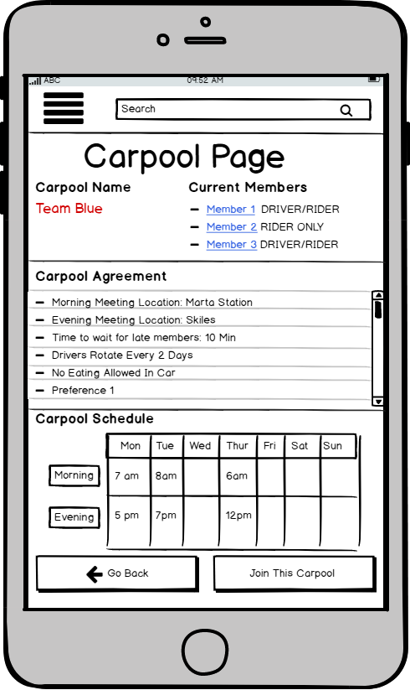
5
The list of current members gives users the ability to click on a member’s name to view said member’s profile. Also The list displays the roles each member plays in the carpool group
The Carpool Page contains all of the carpool’s information such as the carpool’s name, members, and agreements
The Carpool Page has the carpool agreement which includes all of the rules the carpool group has agreed on such as meeting locations, car rules, and how late carpool members can be before the group will just leave
The Carpool Page has the schedule of the carpool openly displayed on the screen even though the information is in the carpool agreement so that people can quickly view it when searching
The consumer can view the details of the carpool group on it’s carpool page and either choose to join the group or go back to go back to the suggested list

Slide 5
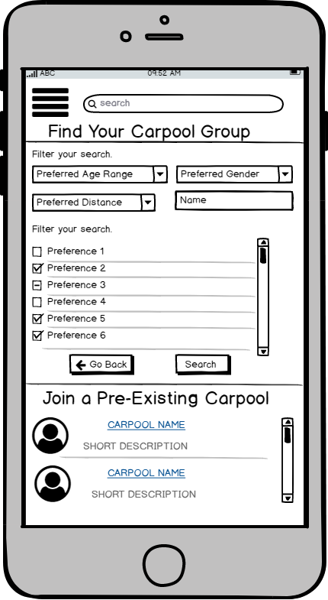
6
7
Users can filter through the list of pre-existing carpools and carpool members by customizing the search to look for people that match a specific preference, age range, gender or any other sort of criteria.
A list of all possible carpools are listed at the bottom of the screen.
The consumer can customize their own search to find the perfect carpool. They start the search by pressing the search button.
The consumer has the option to search for their own carpool instead of using the recommendations provided

Slide 6
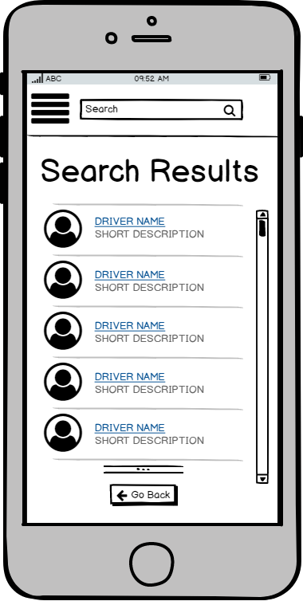
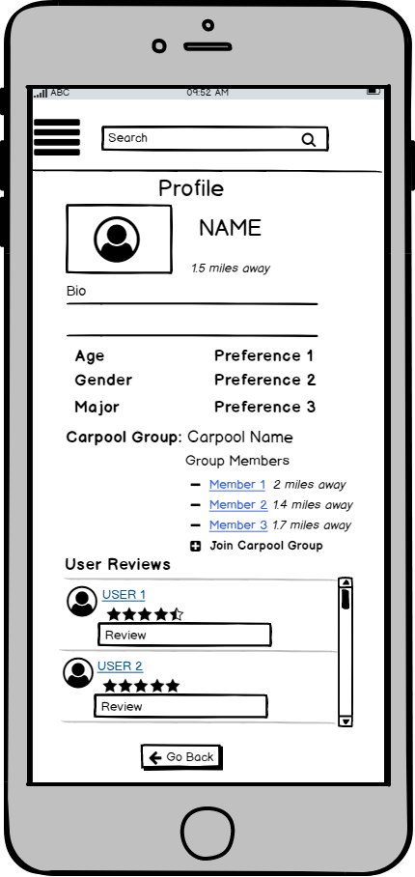
8
9
When you look at someone’s profile you can see their preferences, the carpool groups they’re a part of, as well as any additional information they decide to include.
When you look at someone’s profile you can see the reviews that other people that have carpooled with this user have left. You can also click on the profile of those that left the review to see if the review is credible
The consumer can click onto an eligible carpool group or user’s name to view their profile
When the consumer views another user’s profile, they can decide if they want to join a group that the user is in. To do so they only need press the plus sign to join the group

Slide 7
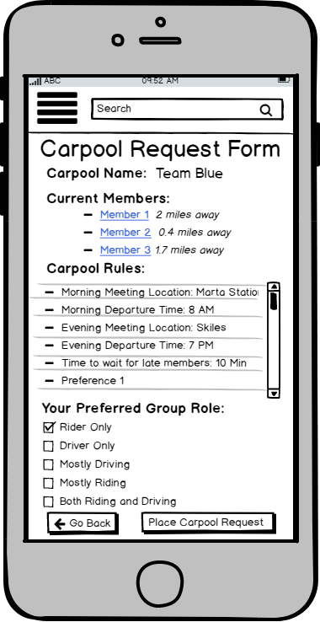
10
The carpool request form allows users to look at all of the rules the carpool group has made in their carpool agreement
The carpool request form shows users a list of all the members in the group and how far each members lives from the user seeking entry to the group
When seeking entry to a carpool group, the user enters what they want their role in the group to be.
The Carpool Request form allows the consumer to review all of the information about the carpool. If the consumer decides to join the group, they only need press a button to send the request to join to the carpool group

Slide 8
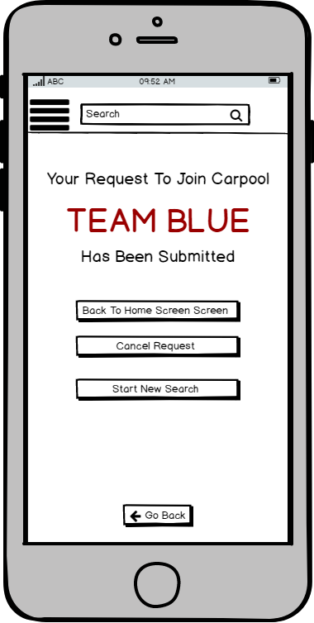
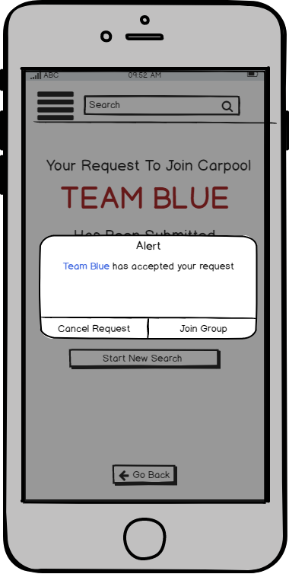
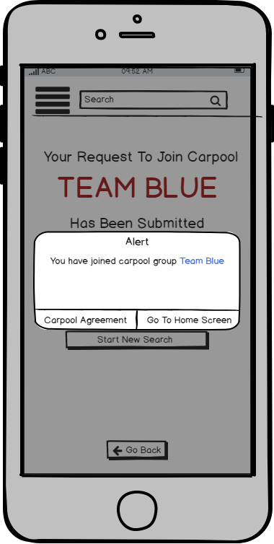
11
12
13
When the consumer sends a request to join a carpool group the app will use this screen to confirm that the request has successfully been sent.
If a carpool group accepts the consumer’s request. The app alerts the consumer of this development and will give the consumer a chance to decide to join the group or cancel their request.
If the consumer confirms that they would still like to join the carpool group, the app will show that consumer has successfully joined the group. The consumer can then choose to look at the carpool agreement again to make sure everything still works with their schedule

Slide 9
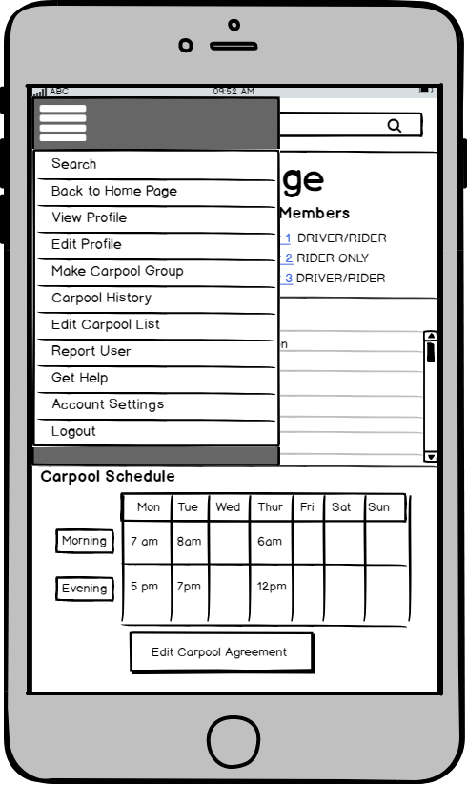
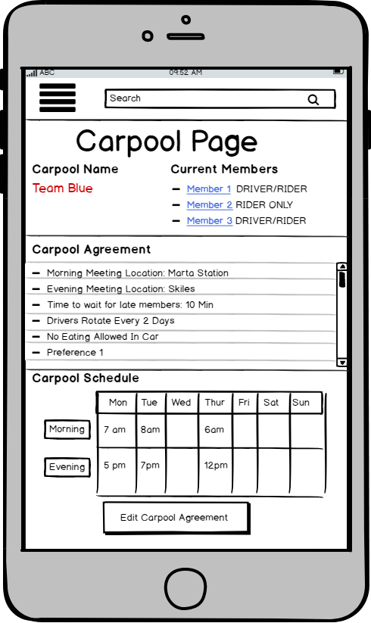
15
14
The “Edit Carpool Agreement” button to remove themselves from a carpool group or to send out a request to change one of the carpool rules. In the latter case each member will have to approve the change before it can be made.
When the consumer becomes a part of a carpool, they have access to send an edit to the carpool page.
The menu button allows the consumer to go back to the main page

Slide 10
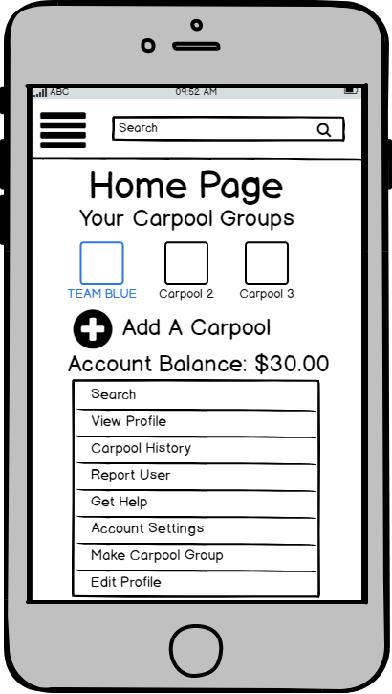
16
The home page will update to show all of the added carpool groups
Benchmark 1
Completed
After a consumer is a part of a carpool group, they can see the carpool group on their home page

